Slide 1
Chapter 10: Mass-Storage Systems

Slide 2

Since main memory is usually too small to accommodate all the data and programs permanently, the computer system must provide secondary storage to back up main memory. Modern computer systems use disks as the primary on-line storage medium for information (both programs and data).

Slide 3

Overview of Magnetic Disks
Magnetic disks provide bulk of secondary storage of modern computers
  Each disk platter has a flat circular shape, like a CD
  We store information by recording it magnetically on the platters
  A read–write head “flies” just above each surface of every platter
  The surface of a platter is logically divided into circular tracks, which are subdivided into sectors. The set of tracks that are at one arm position makes up a cylinder.
Notes:
In this section, we present a general overview of the physical structure of hard disk
The two surfaces of a platter are covered with a magnetic material
The heads are attached to a disk arm that moves all the heads as a unit.

Slide 4
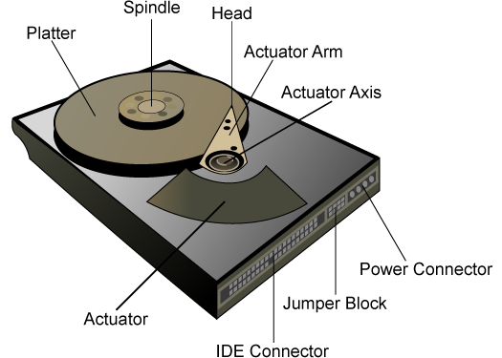
Hard Drive Hardware

Slide 5
Addressing and Geometry
Externally, hard drives expose a large number of sectors (blocks)
  Typically 512 or 4096 bytes
  Individual sector writes are atomic
  Multiple sectors writes may be interrupted
Drive geometry
  Sectors arranged into tracks
  A cylinder is a particular track on multiple platters
  Tracks arranged in concentric circles on platters
  A disk may have multiple, double-sided platters
Drive motor spins the platters at a constant rate
  Measured in revolutions per minute (RPM)

Slide 6
Geometry Example
Sector
Three tracks
11
12
13
10
23
24
25
14
32
9
22
31
33
26
15
Rotation
Read head
8
21
30
34
27
0
7
20
29
35
16
1
Seeks across the various tracks
28
6
19
17
2
18
5
4
3
Outer tracks hold more data
One platter

Slide 7
Types of Delay With Disks
Long delay
Three types of delay
Rotational Delay
  Time to rotate the desired sector to the read head
  Related to RPM
Seek delay
  Time to move the read head to a different track
Transfer time
  Time to read or write bytes
Rotation
11
12
13
10
23
24
25
14
32
9
22
31
33
26
15
8
21
30
34
27
0
7
20
29
35
16
1
28
6
19
17
2
18
5
4
3
Track skew: offset sectors so that sequential reads across tracks incorporate seek delay
Short delay

Slide 8
Overview of Magnetic Disks
When the disk is in use, a drive motor spins it at high speed
Disk speed has two parts
  Transfer rate is rate at which data flow between drive and computer
  Positioning time (random-access time)
    Seek time is the time for the disk arm to move the heads to the cylinder containing the desired sector
    Rotational latency is the additional time for the disk to rotate the desired sector to the disk head

Slide 9



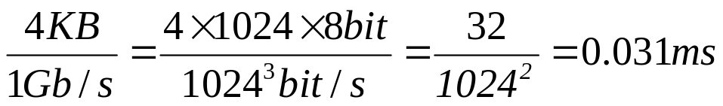
Hard Disk Performance
Positioning time = seek time + rotational latency
  For fastest disk 3ms + 2ms = 5ms
  For slow disk 9ms + 5.56ms = 14.56ms
Average I/O time = Positioning time + (amount to transfer / transfer rate) + controller overhead
For example, to transfer a 4KB block on a 7200 RPM disk with a 5ms average seek time, 1Gb/sec transfer rate with 0.1ms controller overhead
  Rotational latency = (1/120)/2 = 4.17ms
  5ms + 4.17ms + 0.1ms + transfer time =
  Transfer time =
  Average I/O time for 4KB block = 9.27ms + 0.031ms = 9.301ms

Slide 10
Disk Scheduling
The OS is responsible for using hardware efficiently — for the disk drives, this means having a fast access time (Positioning time) and large disk bandwidth
Minimize seek time
Seek time ≈ seek distance
Disk bandwidth is the total number of bytes transferred, divided by the total time between the first request for service and the completion of the last transfer
We can improve both the access time and the bandwidth by managing the order in which disk I/O requests are serviced

Slide 11

FCFS
A disk queue with requests for I/O to blocks on cylinders
This algorithm is intrinsically fair, but it generally does not provide the fastest service
The wild swing from 122 to 14 and then back to 124 illustrates the problem with this schedule.
Illustration shows total head movement of 640 cylinders
Notes:
Consider, for example, a disk queue with requests for I/O to blocks on cylinders
If the disk head is initially at cylinder 53

Slide 12
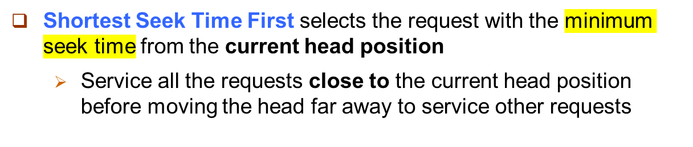

SSTF
Illustration shows total head movement of 236 cylinders

Slide 13
SSTF (cont.)
Think about one downside of SSTF
SSTF may cause starvation of some requests
Although the SSTF algorithm is a substantial improvement over the FCFS algorithm, it is not optimal
  See next algorithm
Notes:
Remember that requests may arrive at any time.
Suppose that we have two requests in the queue, for cylinders 14 and 186, and while the request from 14 is being serviced, a new request near 14 arrives. This new request will be serviced next, making the request at 186 wait.
While this request is being serviced, another request close to 14 could arrive.
In theory, a continual stream of requests near one another could cause the request for cylinder 186 to wait indefinitely.

Slide 14
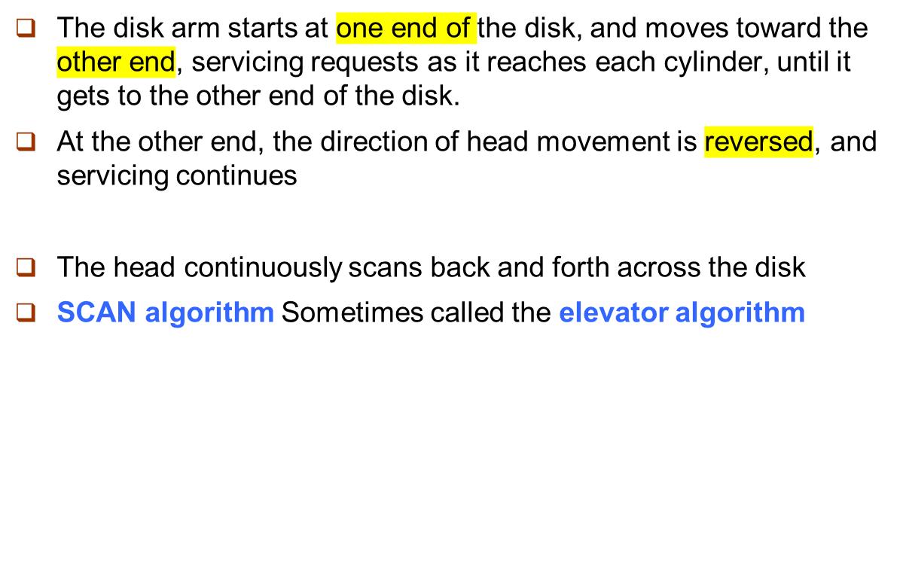
SCAN
Notes:
Elevator algorithm: since the disk arm behaves just like an elevator in a building, first servicing all the requests going up and then reversing to service requests the other way.

Slide 15

SCAN (Cont.)
If a request arrives in
the queue just in front of the head, it will be serviced almost immediately;
A request arriving just behind the head will have to wait until the arm moves to the end of the disk, reverses direction, and comes back.
Illustration shows total head movement of 208 cylinders
Notes:
Assuming that the disk arm is moving toward 0
At cylinder 0, the arm will reverse and will move toward the other end of the disk

Slide 16
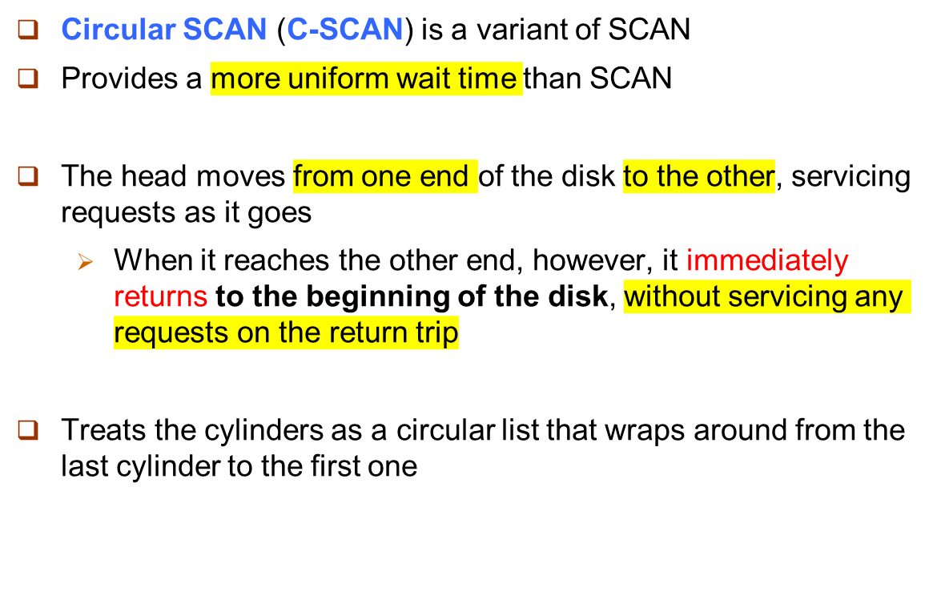
C-SCAN

Slide 17

C-SCAN (Cont.)
Total number of cylinders?

Slide 18
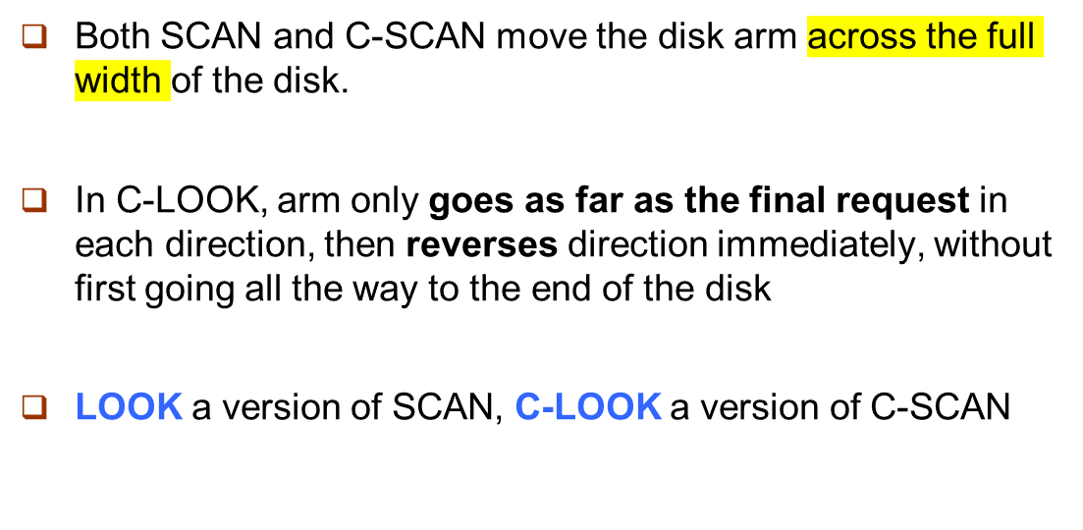
C-LOOK

Slide 19

C-LOOK (Cont.)

Slide 20
Selecting a Disk-Scheduling Algorithm
SSTF is common and has a natural appeal
SCAN and C-SCAN perform better for systems that place a heavy load on the disk
  Less starvation
Requests for disk service can be influenced by the file-allocation method
  e.g., a contiguously allocated file resulting in limited head movement
  e.g., a linked or indexed file, blocks that are widely scattered on the disk, resulting in greater head movement
What about rotational latency?
  Difficult for OS to schedule for improved rotational latency

Slide 21
Beyond Single Disks
Hard drives are great devices
  Relatively fast, persistent storage
Shortcomings:
  How to cope with disk failure?
    Mechanical parts break over time
    Sectors may become silently corrupted
  Capacity is limited
    Managing files across multiple physical devices is cumbersome
    Can we make 10x 1 TB drives look like a 10 TB drive?

Slide 22
Redundant Array of Inexpensive Disks
RAID: use multiple disks to create the illusion of a large, faster, more reliable disk
Externally, RAID looks like a single disk
  i.e. RAID is transparent
  Data blocks are read/written as usual
  No need for software to explicitly manage multiple disks or perform error checking/recovery
Internally, RAID is a complex computer system
  Disks managed by a dedicated CPU + software
  RAM and non-volatile memory
  Many different configuration options (RAID levels)

Slide 23
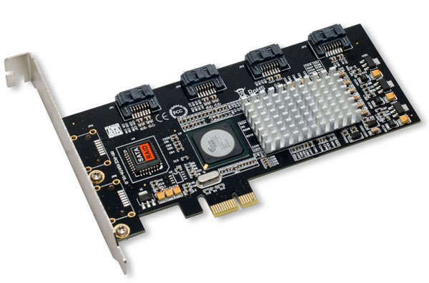
Example RAID Controller
SATA ports
RAM
CPU
Non-volatile storage

Slide 24
RAID 0: Striping
Key idea: present an array of disks as a single large disk
Maximize parallelism by striping data cross all N disks
Disk 0
Disk 1
Disk 2
Disk 3
Sequential accesses spread across all drives
Data block = 512 bytes
0
4
8
12
1
5
9
13
2
6
10
14
3
7
11
15
Random accesses are naturally spread over all drives
Stripe

Slide 25
Addressing Blocks
How do you access specific data blocks?
  Disk = logical_block_number % number_of_disks
  Offset = logical_block_number / number_of_disks
Example: read block 11
  11 % 4 = Disk 3
  11 / 4 = Physical Block 2 (starting from 0)
Disk 0
Disk 1
Disk 2
Disk 3
0
4
8
12
1
5
9
13
2
6
10
14
3
7
11
15

Slide 26
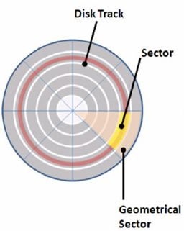
Old type
Are there same number of sectors in different tracks?
  There are two types of disk
    old type: the same number of sectors in different tracks
    new type: the different number of sectors in different tracks
We can observe:
sectors increase in size farther away from the center.
the rotation speed increases farther away from the center.
old type

Slide 27
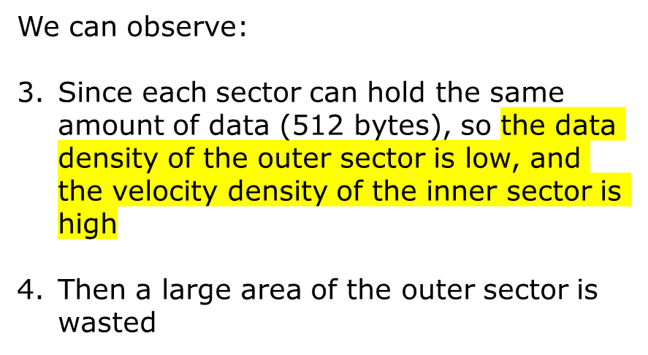
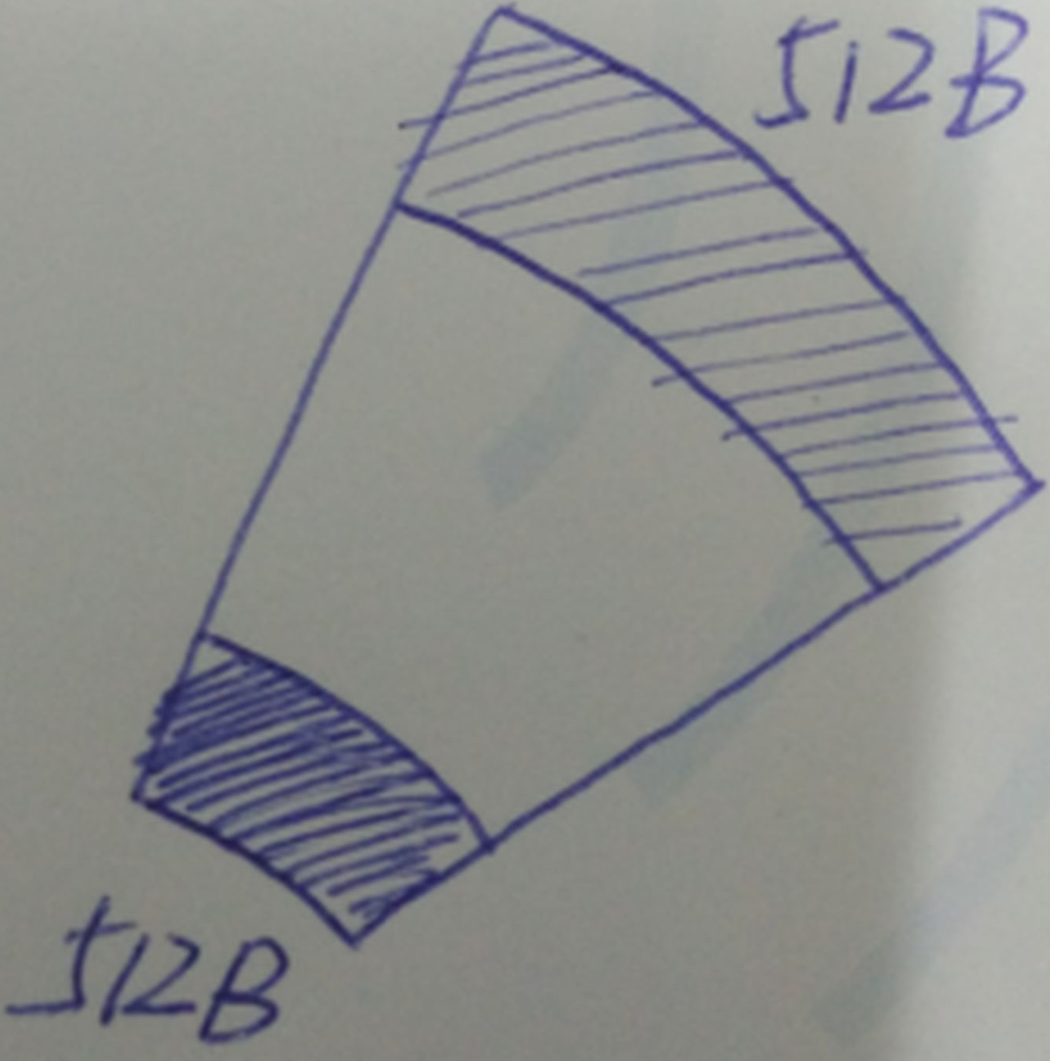
Old type
old type

Slide 28
New type
Since tracks increase in size further away from the center, the more sectors should be divided, each with the same area and the same amount of data
11
12
13
10
23
24
25
14
32
9
22
31
33
26
15
8
21
30
34
27
0
7
20
29
35
16
1
28
6
19
17
2
18
5
4
3
Outer tracks hold more data
One platter

Slide 29
Review: old type
If you have an empty hard disk and now write to a file, do you write to all sectors of the same track first and then write to another track?
  Yes, write the file from outside to inside, first filling the outermost track, then the inner track.
Why after one disk is used for a long time, its read and write speed will be slow?
  Because when the outer track is used up, start to use the inner track
  Tracks decrease in read/write speed further close to the center
  Then disk organization or formatting is needed, which allows the outer track to be used
磁盘碎片整理

Slide 30
Transfer Time
The time it takes to transmit or move data from one place to another.
It is the time interval between the start of the transfer and the completion of the transfer.
Pretty fast — depends on RPM and sector density.

Slide 31
Transfer Time
T = b/rN
  T is Transfer time
  b is number of bytes to be transferred
  N is number of bytes on a track
  r is rotational speed in RPM

Slide 32
Workload Performance
So…
  seeks are slow
  rotations are slow
  transfers are fast
What kind of workload is faster for disks?
  Sequential: access sectors in order (transfer dominated)
  Random: access sectors arbitrarily (seek+rotation dominated)

Slide 33
Disk Spec
 | Cheetah | Barracuda
Capacity | 300 GB | 1 TB
RPM | 15,000 | 7,200
Avg Seek | 4 ms | 9 ms
Max Transfer | 125 MB/s | 105 MB/s
Platters | 4 | 4
Cache | 16 MB | 32 MB
Sequential workload: what is throughput for each?
  Cheetah: 125 MB/s
  Barracuda: 105 MB/s

Slide 34
Disk Spec
 | Cheetah | Barracuda
Capacity | 300 GB | 1 TB
RPM | 15,000 | 7,200
Avg Seek | 4 ms | 9 ms
Max Transfer | 125 MB/s | 105 MB/s
Platters | 4 | 4
Cache | 16 MB | 32 MB
Random workload: what is throughput for each?
Assume size of each random read is 16KB

Slide 35
Time = seek + rotate + transfer
 | Cheetah | Barracuda
RPM | 15,000 | 7,200
Avg Seek | 4 ms | 9 ms
Max Transfer | 125 MB/s | 105 MB/s
Seek = 4 ms
Full rotation = 60 / (15,000) = 4 ms Half rotation = 2 ms
Transfer = 16 KB / 125 MBps = 125 us
Throughput = 16 KB / (6.125 ms) = 2.5 MBps

Slide 36
Time = seek + rotate + transfer
 | Cheetah | Barracuda
RPM | 15,000 | 7,200
Avg Seek | 4 ms | 9 ms
Max Transfer | 125 MB/s | 105 MB/s
Seek = 9 ms
Full rotation = 60 / (7,200) = 8.3 ms Half rotation = 4.1 ms
Transfer = 16 KB / 100 MBps = 160 us
Throughput = 16 KB / (13.260 ms) = 1.2 MBps

Slide 37
 | Cheetah | Barracuda
Capacity | 300 GB | 1 TB
RPM | 15,000 | 7,200
Avg Seek | 4 ms | 9 ms
Max Transfer | 125 MB/s | 105 MB/s
Platters | 4 | 4
Cache | 16 MB | 32 MB
 | Cheetah | Barracuda
Sequential | 125 MB/s | 105 MB/s
Random | 2.5 MB/s | 1.2 MB/s
This shows the importance of proper disk scheduling
to achieve good disk performance.

Slide 38
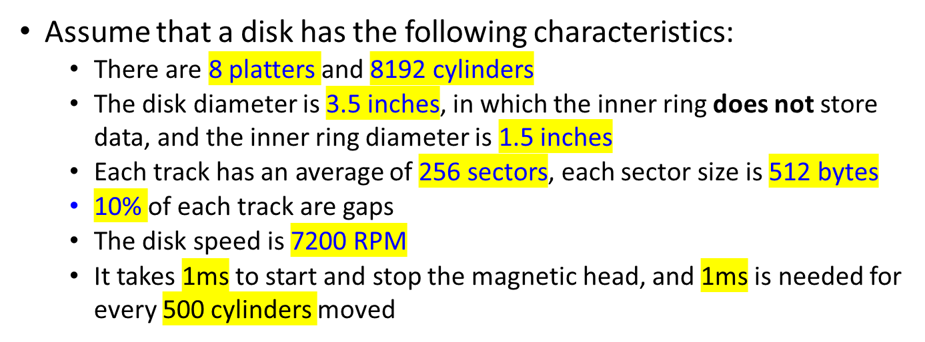
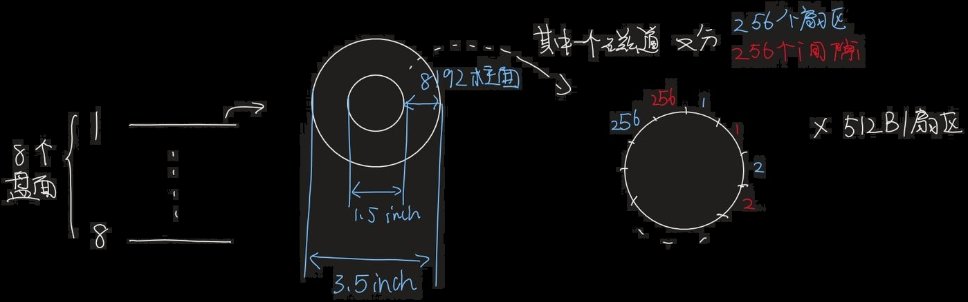
Exercise 1

Slide 39
Exercise 1
What’s the disk size?
Answer：
C = 8 platters * 8192 cylinders * 256 sectors * 512bytes/sector = 8GB

Slide 40
Exercise 1
If all the tracks have the same number of sectors, what is the density (bits per inch) of the innermost track?
Answer：
Track density = track capacity c / track length l
Because all tracks have the same number of sectors, all tracks have the same capacity: c = 256 sectors * 512 Bytes/sector * 8 bits
Since for each track, gap part occupies 10%, so efficient track part occupy 90%.
Then the length of the innermost track is: l = 1.5 inch * π * 90%
So the density of the innermost track is c/l = 247,238.598 bpi

Slide 41
Exercise 1
What is the transfer time for a block with 8KB?
Answer：
One track capacity c = 256 sectors * 512 Bytes/sector = 2⁷ KB, so this 8KB block is in one track.
Transfer time T_{t} = the ratio of a block to a track * the time it takes to make one disk revolution
8KB / (512B/sector) = 16 sectors. There are 15 gaps between sector 1 and 16. A track has 256 sectors accounting for 90%, 256 gaps accounting for 10%
Therefore, the ratio of a block to a track is:
(16/256) * 90% + (15/256) * 10% = 0.0617
One disk revolution takes: 1 / (7200 RPM) = 8.333 ms
Therefore, T_{t} = 0.0617 * 8.333 ms = 0.514 ms

Slide 42
Exercise 1
What’s the average seek time?
Answer：
Average seek time T_{f}= head start/stop time + average track number to move * movement time between adjacent tracks
Average track number to move = 8192 tracks / 3 = 2730 tracks
T_{f} = 1 ms + 2730 tracks * (1ms / 500 tracks) = 6.5 ms

Slide 43
Exercise 1
What’s the average rotation time?
Answer：
One disk revolution takes: 1 / (7200 RPM) = 8.333 ms
Average rotation time T_{r}= half of 1 round time
Then T_{f} = 8.333ms / 2 = 4.17ms

Slide 44
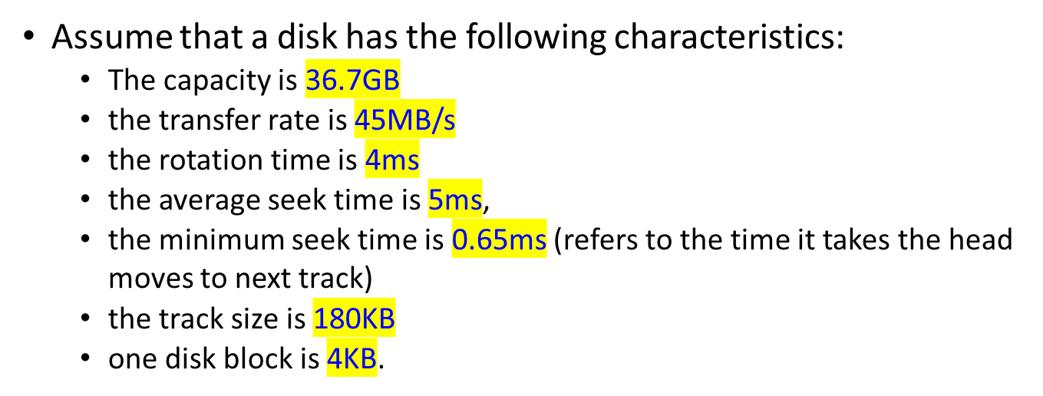
Exercise 2

Slide 45
Exercise 2
How long does it take to randomly read 1000 disk blocks?
Random reads: reading each block needs to seek, rotate and transfer
Therefore, the time to read a block at random: t = average seek time t₁ + average rotation time t₂ + transfer time of a block with 4KB t₃
t₁ = 5 ms, t₂ = 4 ms / 2 = 2 ms
The transfer time of a block = the ratio of a block to a track * the time it takes to make one revolution
So t₃ = (4KB / 180KB) * 4ms = 0.09ms
t= 4 ms + 2 ms + 0.09 ms
Randomly read 1000 blocks time = 1000 * t = 7090 ms

Slide 46
Exercise 2
Assuming the 1000 blocks are stored contiguously on a single track and all the blocks are stored on adjacent tracks, how long does it take to read the 1000 blocks?
The number of tracks required for 1000 4KB blocks = (1000 * 4KB) / (180 KB/ track) = 23 tracks, so the read will cross adjacent tracks 22 times.
Since blocks are stored contiguously, as long as the first track seek t₁ and
Rotational delay (for sector) t₂
plus the transfer time t₃ and
the time across adjacent tracks t₄
t₁ = 5ms; t₂ = 2ms, t₃ = 0.09ms; t₄ = 0.65ms
Therefore, the time to read 1000 consecutive blocks = t₁ + t₂ + 1000* t₃ + 22* t₄ = 111.3ms

Slide 47
End of Chapter 10

